Slide 1
Phishing Awareness Training
Presented By: Sami

Slide 2
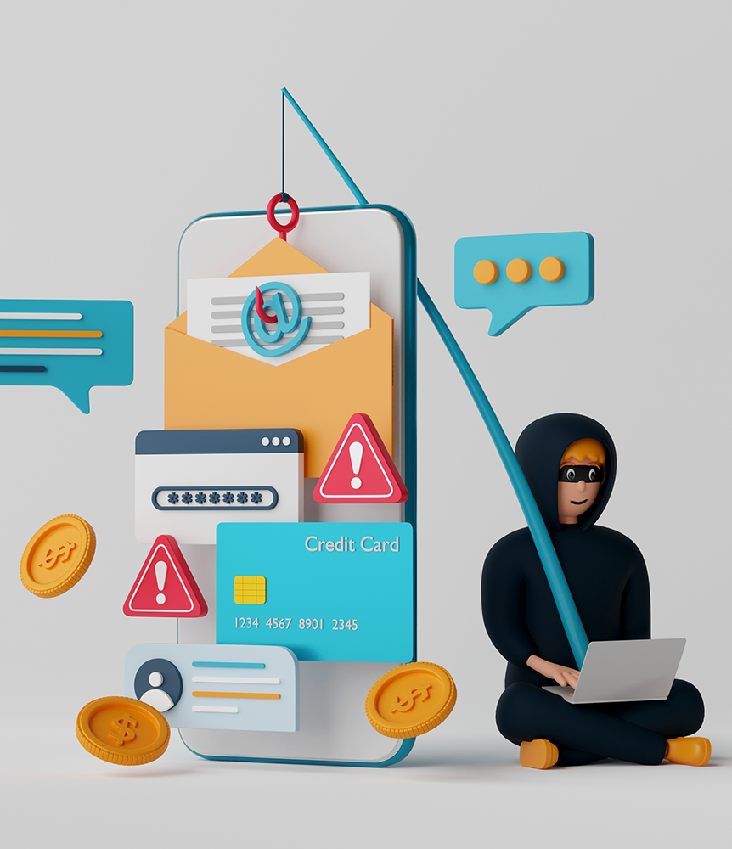
Introduction
Phishing attacks are social engineering strategies designed to steal sensitive user information by tricking individuals into engaging with malicious content. Understanding the various types and techniques of phishing is essential for effective protection.
Phishing can lead to severe consequences, including data breaches and financial loss, particularly in corporate and governmental settings. Recognizing its impact is crucial for maintaining security.

Slide 3

Explanation:

Slide 4
Phishing Techniques:
There are several common types of phishing, including email phishing, spear phishing, and whaling, each targeting different victims with varying techniques. Awareness of these types helps in prevention.
Phishing techniques involve spoofing email addresses and creating fake websites that appear trustworthy, making it difficult for victims to identify the threat. Vigilance is key in avoiding these traps.

Slide 5

Spear Phishing:
Spear phishing is a targeted type of phishing where attackers send deceptive emails aimed at a specific person or organization, making them seem more believable.
Unlike regular phishing, which reaches a wide audience, spear phishing involves detailed research to find personal information about the victim, such as their name, job role, and connections.
Attackers often impersonate someone familiar, like a coworker or business partner, to craft a convincing message.
Their goal is to trick the recipient into revealing sensitive information, such as passwords or financial details, or to install harmful software on their devices.
Due to its personalized approach, spear phishing is often more successful than typical phishing attacks and poses a significant risk to both individuals and organizations.

Slide 6
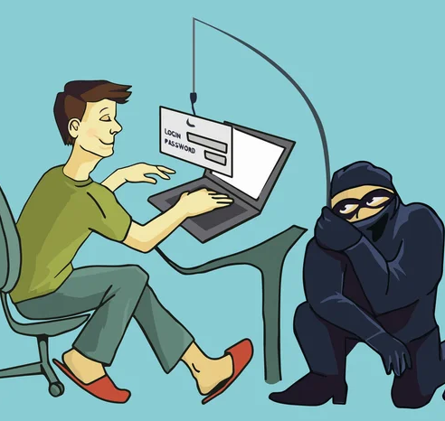
Whaling phishing:
Whaling attacks target high-profile individuals like CEOs by tricking them into revealing sensitive information through highly customized phishing tactics. These scams exploit personal communication methods, making them hard to detect. Whaling, a type of spear phishing, specifically targets high-value individuals in organizations, leveraging their authority and often insecure communication methods. This increases their vulnerability to attacks. The attackers often gather information over time to create convincing emails that appear to be from trusted sources, increasing the likelihood of success for their scams. Personalized content in whaling attacks includes the target's name and job title, making detection difficult. This sophisticated approach enhances the effectiveness of the phishing attempts.

Slide 7
How to Prevent Phishing?
Phishing attacks can manipulate users into providing sensitive information through deceptive emails or messages. Recognizing these scams is crucial for protecting personal and organizational data.
Email authentication can significantly enhance security by verifying the legitimacy of senders. This helps users identify fraudulent communications more effectively.
Users should be cautious of emails requiring urgent personal information, especially when prompted by unfamiliar sources. Verifying the sender is essential to avoid falling victim to scams.
Training and education on phishing awareness are vital for end users. This knowledge equips individuals to recognize and respond to potential phishing attempts appropriately.

Slide 8
Example:
One well-known real-life example of a phishing attack is the Target data breach that occurred in late 2013. In this case, attackers used phishing techniques to gain access to Target's network and subsequently stole credit and debit card information from approximately 40 million customers.
The attack began with a phishing email sent to a third-party vendor that had access to Target’s systems, specifically a vendor that provided heating and cooling services. The attackers crafted a convincing email that appeared to come from a legitimate source, prompting an employee at the vendor to open a malicious attachment. This infected the vendor’s network with malware, providing the attackers with access to Target’s system.

Slide 9
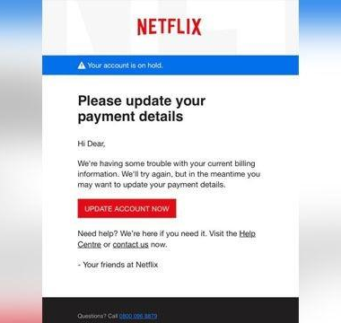
Summary:
A phishing attack is a cybercrime in which attackers pretend to be legitimate organizations or individuals to trick victims into revealing sensitive information, such as passwords, credit card numbers, or personal details. This is usually done through fake emails, messages, or websites that look real. Phishing attacks take advantage of psychological tactics, often creating a sense of urgency or fear to encourage targets to click on harmful links or download malicious attachments. As a common cybersecurity threat, phishing can result in identity theft, financial loss, and data breaches, making it crucial for individuals to stay informed and cautious when interacting online.

Slide 10
Thank You

